Slide 1
How to Register for Tournaments, Events, and Solutions to Problems
Buffalo’s Table Hockey Festival, Exhibition, and Championships, 22-24 Nov. @ Buffalo’s RiverWorks

Slide 2
“The guidance provided on the following pages can be applied to registering for any of our events.”
–WTHA

Slide 3
You Arrive to the Pro TH Tournament Registration page
https://wtha.com/event/bflostrong19/
Scroll to the bottom of the page

Slide 4
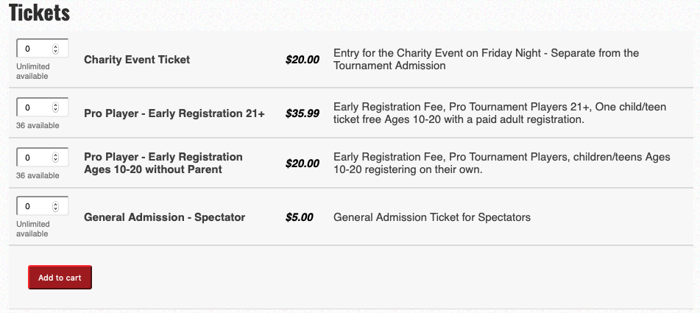
Tickets - Bottom of the Pro TH Tournament Registration page
https://wtha.com/event/bflostrong19/
Scenario: A family of four (4), Dad wants him and his son and daughter to play in the same, Pro, tournament. Because Dad is registering to play, now one of his children can play for FREE. His wife wants to watch them play. Also, all of them want to attend Friday Night’s Charity Event.
Note: There are 36 tickets that remain available for this event.

Slide 5
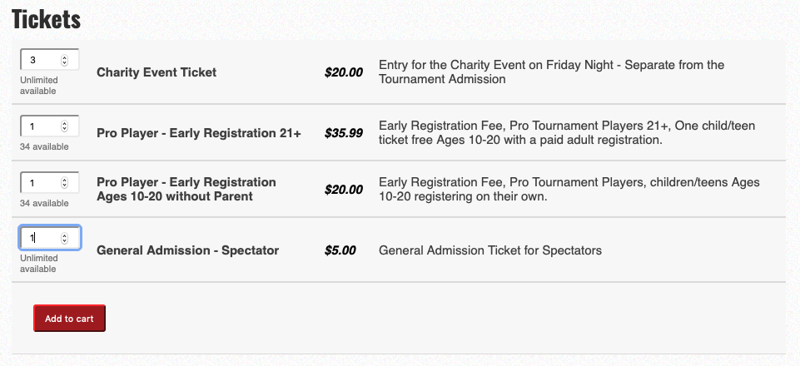
Registering a Family of Four
Scenario: A family of four (4), Dad wants him and his son and daughter to play in the same, Pro, tournament. Because Dad is registering to play, now one of his children can play for FREE. His wife wants to watch them play. Also, all of them want to attend Friday Night’s Charity Event.
So, they select:
4 Charity Event Tickets
1 Pro Player, age 21+
1 Pro Player, age 10-20
Disregard if you see,
“without parent” or “registering
on their own.”
STEPS: To register one child for FREE, then select only “1” Pro Player Adult 21+ ticket and click “Add to Cart.” Select as many of the tickets in the other categories as you need, for example, Pro Player ages 10-20, Charity, or General Admission.
When you get to the page where you write in your information (Register), you can also add the child’s information whom you are registering for free.

Slide 6
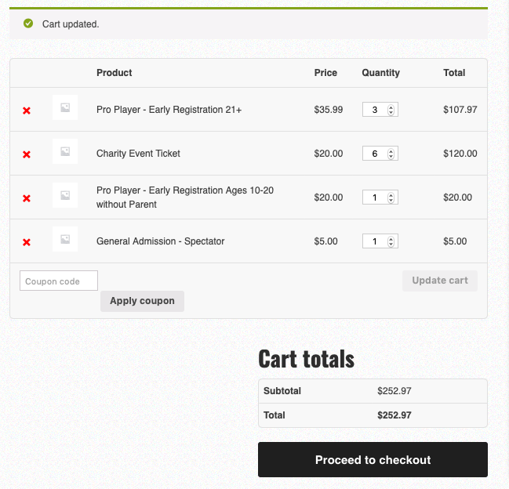
Cart - Quantities Too Many?
Scenario: Family of Four
Let’s say, Dad went to register previously but did not pay. The Cart kept in memory his past selections.
Simply reduce the “Quantity” by selecting how many tickets you need per Product.
Then select, “Update Cart.” Once you are confident you have the correct number of tickets for each Product (category), then click “Proceed to Checkout.”

Slide 7
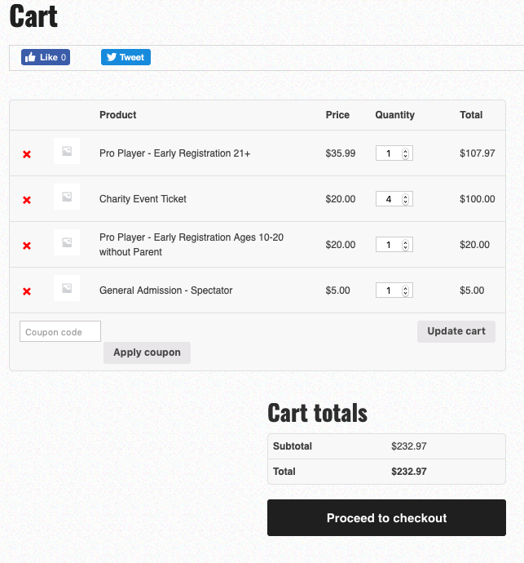
Updated Cart & Proceeding to Checkout
Scenario: Family of Four
On this page you see, Dad, has updated his cart.
He wants:
1 Pro Player age 21+ with Child Free - for his daughter
4 Charity tickets - for his family of four
1 Pro Player age 10-20 - for his son
1 General Admission - for his wife
He is confident his quantities are correct, so he clicks “Proceed to Checkout.”

Slide 8
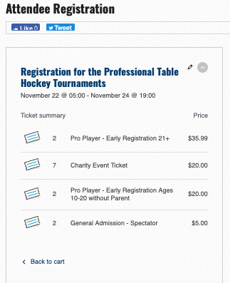
Attendee Registration
Are the Quantities Correct?
If not…
Scenario: Family of Four
On the previous page you see, Dad, checked that all quantities were correct.
But, on the next page he finds the numbers are wrong. (See quantities circled in red).
Remember he wants only:
1 Pro Player age 21+ with Child Free - for his daughter
4 Charity tickets - for his family of four
1 Pro Player age 10-20 - for his son
1 General Admission - for his wife
To fix this click, “Back to Cart”
Go two slides back to slide #7, “Cart - Quantities Too Many?” Once there set the quantities you need, click “Update Cart,” and this will fix the problem.

Slide 9
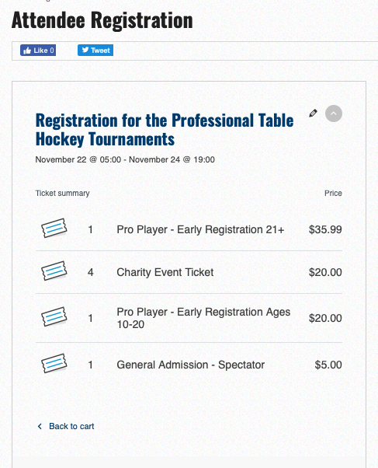
Attendee Registration
Scenario: Family of Four
In this scenario, Dad would see:
1 Pro Player age 21+ with Child Free - for his daughter
4 Charity tickets - for his family of four
1 Pro Player age 10-20 - for his son
1 General Admission - for his wife
The illustration matches what “Dad” has selected.
If your numbers are wrong, go to slide #7, “Cart - Quantities Too Many?” and set the quantities to what you need. This will fix the problem.

Slide 10
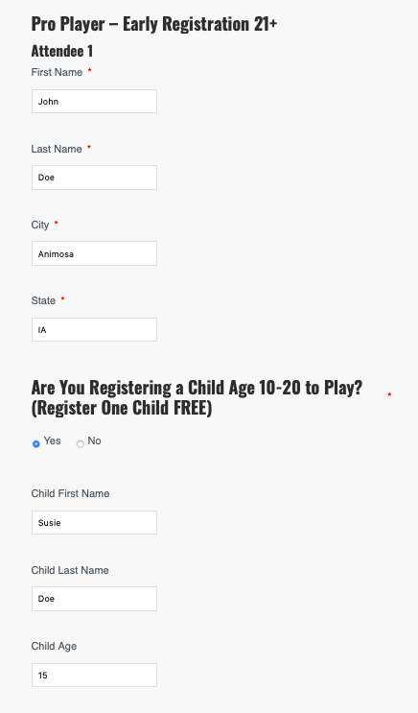
Registration
Scenario: Family of Four
In this scenario, Dad:
Dad registers himself by providing First Name, Last Name, City, and State for “Attendee 1.”
In the section, “Are You Registering a Child Age 10-20 to Play? - Here is where you would add your child’s name and age.
(Each parent or guardian who registers to play in the tournament can register one child for free).

Slide 11
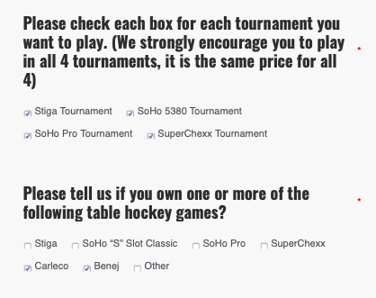
Register for Each or All Tournaments
We, the tournament organizers, need to know who and how many players we have registered for each tournament.
Please check each box next to the tournament you want to play. There is no increase or decrease in price whether you register for one or all four tournaments.
WE STRONGLY ENCOURAGE YOU TO REGISTER AND CHECK THE BOXES FOR ALL FOUR TOURNAMENTS.
If your son or daughter wants to play in more or less tournaments than you do, please send us an email at info@WTHA.com to let us know.
We will also be sending out an email to check with everyone before the tournament of any changes.

Slide 12
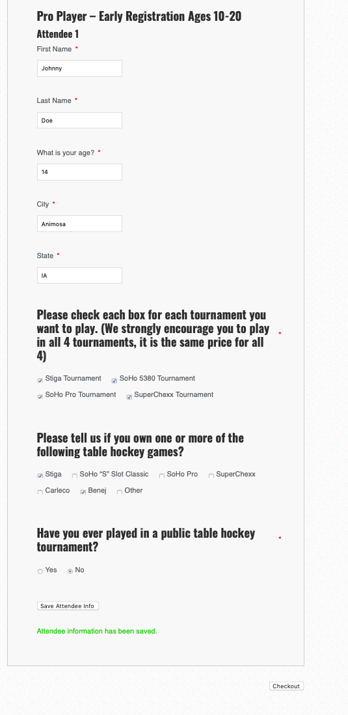
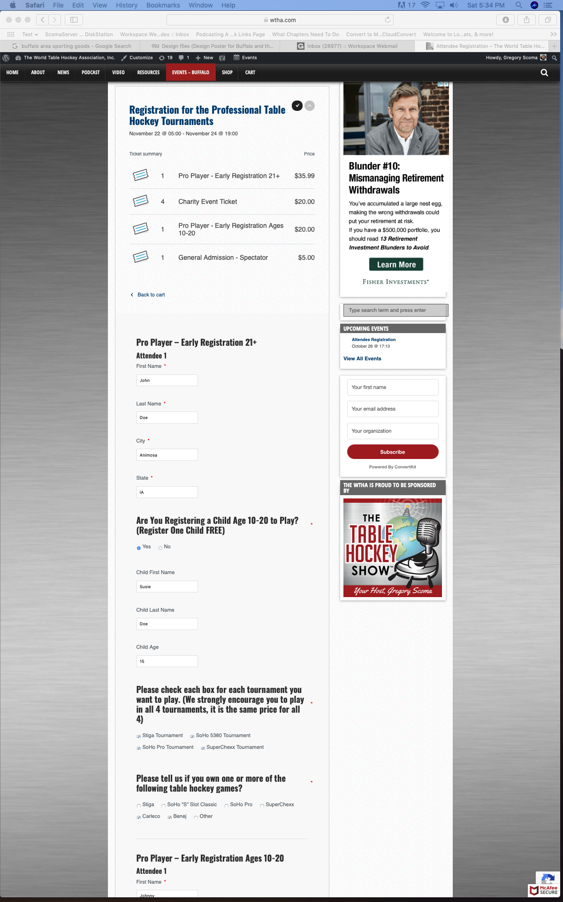
Registering Players
Ages 10-20
Scenario: Family of Four.
Now that Dad has registered himself and one child for free, he can register his second child here.
The only difference here is the question asking if your son or daughter has, “ever played in a public table hockey tournament?”
When you have answered each question, check your information again to make sure it is correct. Click, “Save Attendee Info,” and then should appear “Attendee information has been saved.”
Next, click “Checkout” lower right corner.
————————————————-
We, the tournament organizers, need to know who and how many players we have registered for each tournament.
Please check each box next to the tournament you want to play. There is no increase or decrease in price whether you register for one or all four tournaments.
WE STRONGLY ENCOURAGE EVERYONE TO REGISTER AND PLAY IN ALL FOUR TOURNAMENTS.

Slide 13
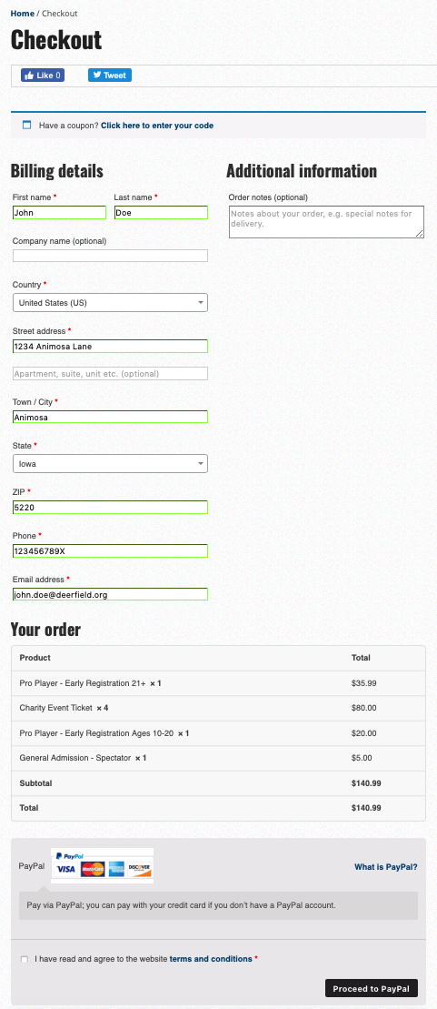
Checkout
Please check that your information is correct.
Then check the box once you have read and agreed to the Terms and Conditions.
Then click “Proceed to PayPal.”
NOTE: You do not need an account with PayPal. On the next page, you can:
log into your PayPal account,
create a PayPal account, -or-
you can pay by credit or debit card.

Slide 14
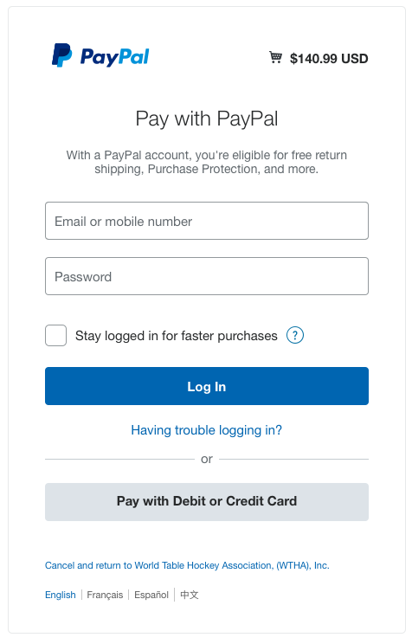
Payment
Log into your PayPal account.
or
Pay by Debit or Credit Card

Slide 15
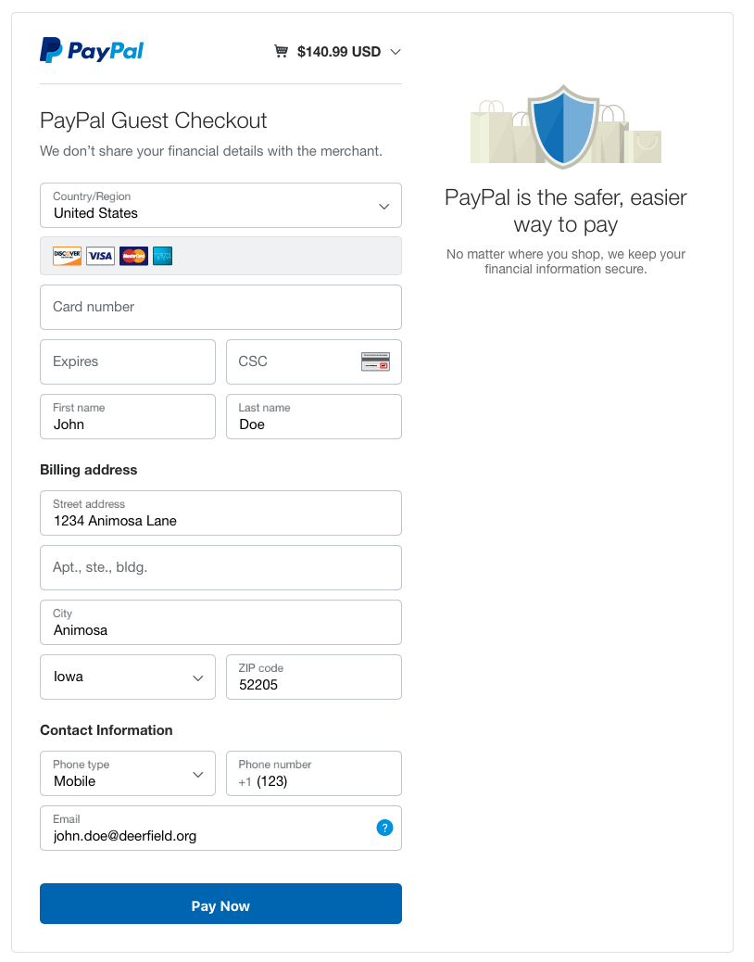
Paying by Debit or Credit Card
If you pay by Debit or Credit Card, you will see this page.
Add you Debit or Credit Card information, check your information as correct, and click “Pay Now.”
That’s it! You are done!
Check your e-mail Inbox for a confirmation e-mail that you are registered.
Thank you!!!
Merci Beaucoup!!!

Slide 16
Still Have Problems?
Call us at 1-855-500-9842 (WTHA)
Or send an email with the subject line, “Problems Registering” to info@wtha.com

